Slide 1

Videogame Playability analysis with Pyspark using players reviews
Big Data Computing-Prof. Gabriele Tolomei
Final project A.Y. 2022/23
MSc in Computer Science
De Sio Ilaria- Matr. 2064970

Slide 2
01 Introduction & Dataset
A brief presentation of the addressed problem and the context
Project Overview
02 Data pre-processing
Data Cleaning, Data Exploration and Text-processing
03 Topic modeling
Content Analysis and Document Coherence score
04 Machine Learning
Prediction hypothesis within the dataset

Slide 3
Introduction
No Man’s sky
Jupiter is the biggest planet in the Solar System
Research Paper
”A Data-Driven Approach for video Game playability Analysis Based on Players reviews”
Framework of Paavilainen
Functionality, Gameplay and Usability

Slide 4


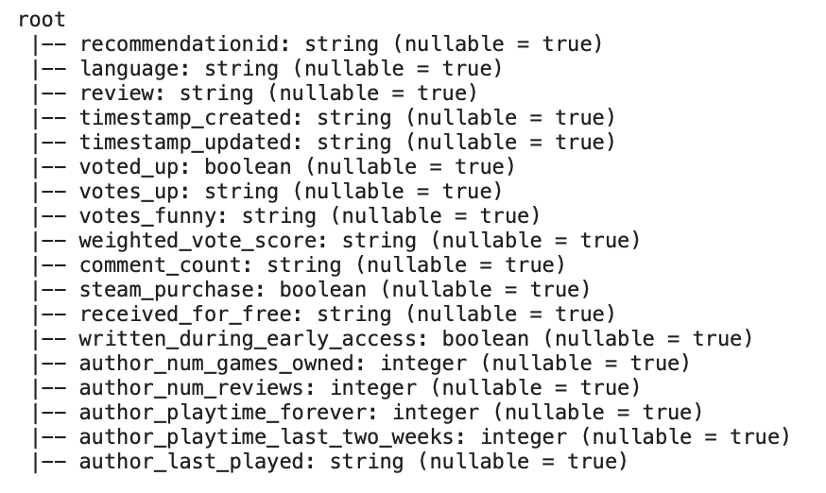

Dataset Description
Shape
Valid values
Initially is 273.742 rows
After Data cleaning ¼ of the dataset only 64.257 rows
Columns
Short reviews
18 columns as in the picture
Duplicates short reviews such as ‘nice game’ ‘good game’

Slide 5
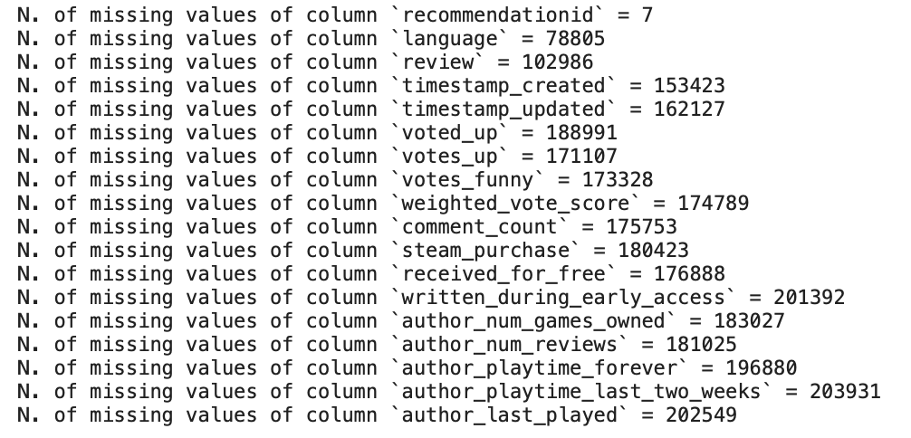
Data Cleaning
3/4
NULL VALUES
1/4
VALID VALUES
64.257 rows

Slide 6
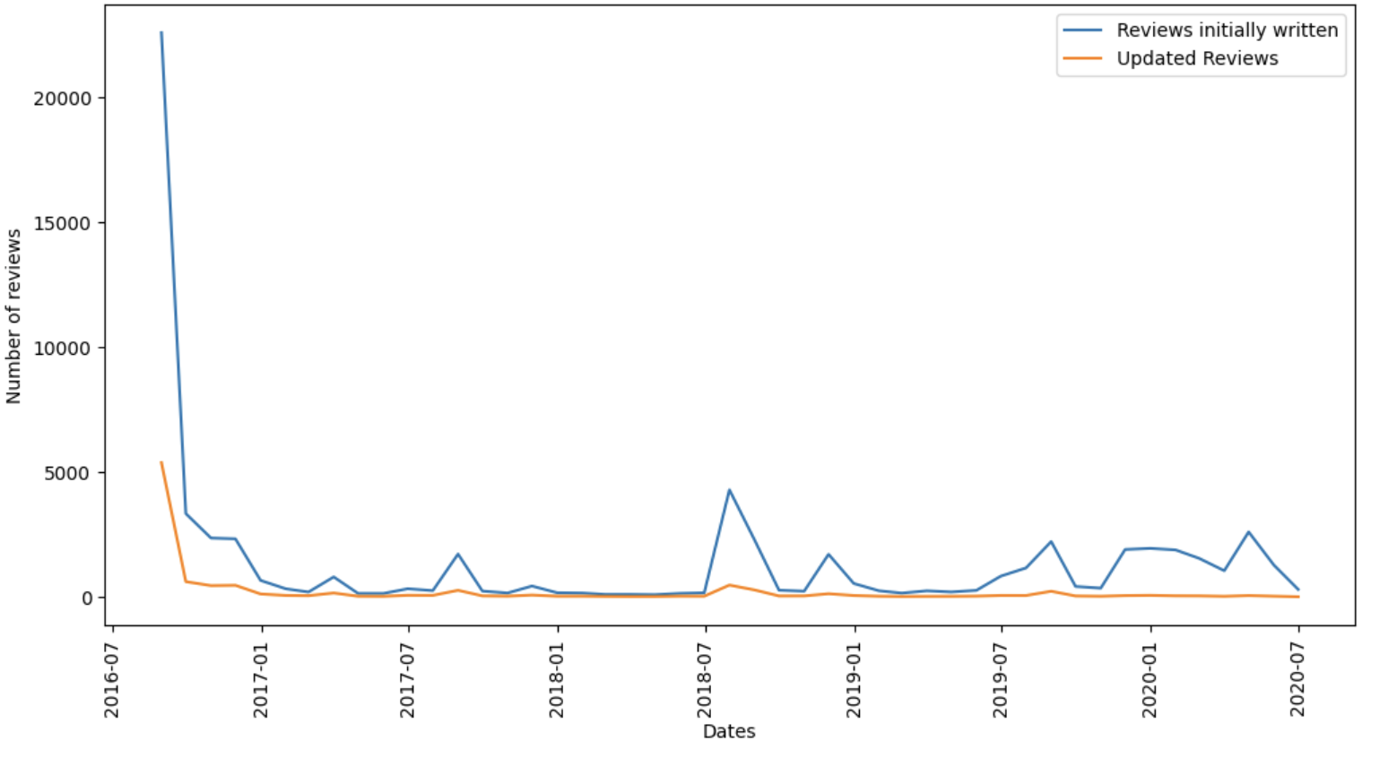
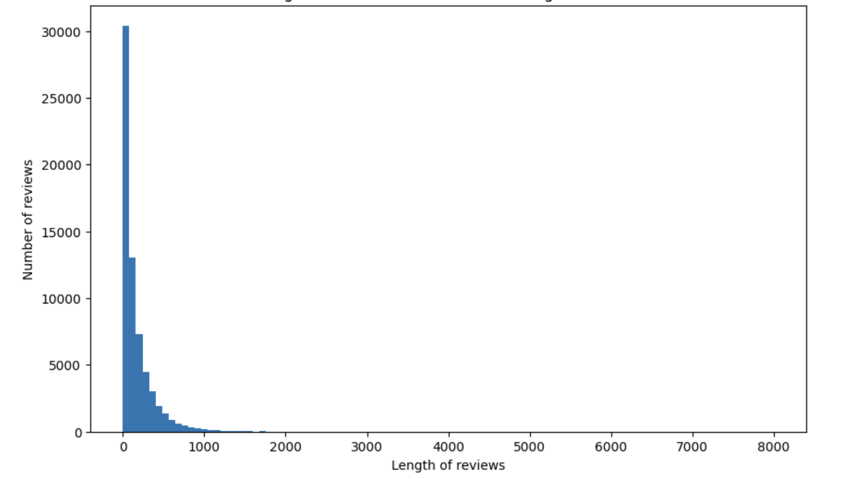
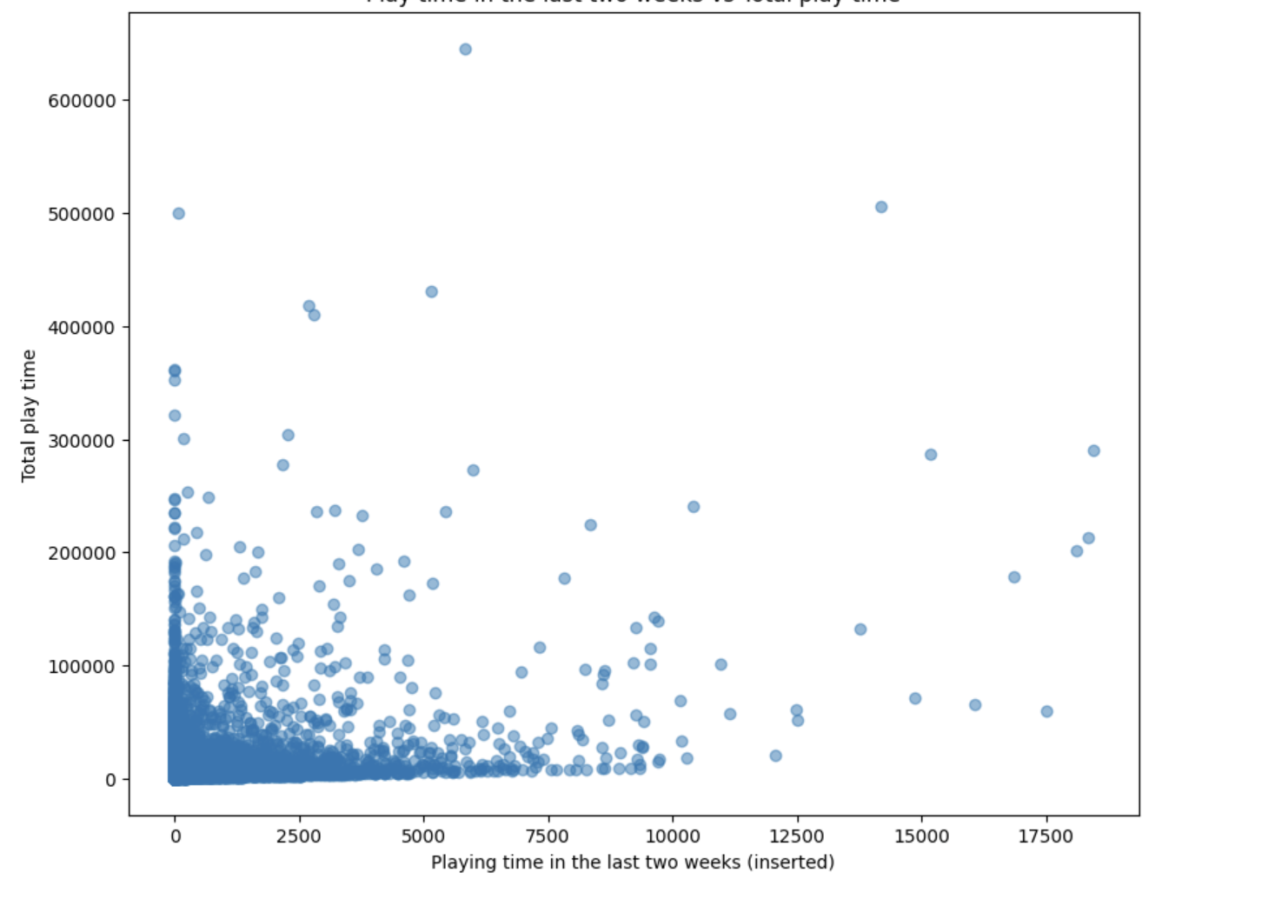
Data exploration
Number of reviews written and updated over time
Distribution of length of reviews
Play time in last two weeks vs total

Slide 7
Text-processing
Divides a text into smaller units called 'tokens’, such as words, phrases or other meaningful units.
Reduces words to their base or dictionary form, lemmas. Common words like "the," "and," or "is”.
Tokenization
Lemmatization, stop-words
N-Grams
Are contiguous sequences of N items, such as Unigrams, Bigrams.
Part-of-Speech(POS)
Filtering
Assign grammatical labels or tags to words in a text based on their syntactic category (NN=noun, VB=verb, JJ=adjective).
Remove DT,PRP,CC and merge all N-Grams.

Slide 8

Topic Modeling
4
3
LDA and Coherence Score
Word Cloud
Topic choice
1
2
Text-processing
Feature Extraction

Slide 9
Topic Modeling
LDA
Jupiter
Mars
Saturn
Neptune
Jupiter is the biggest planet of them all
Despite being red, Mars is actually a cold place
Saturn is a gas giant and has several rings
Neptune is the farthest planet from the Sun

Slide 10
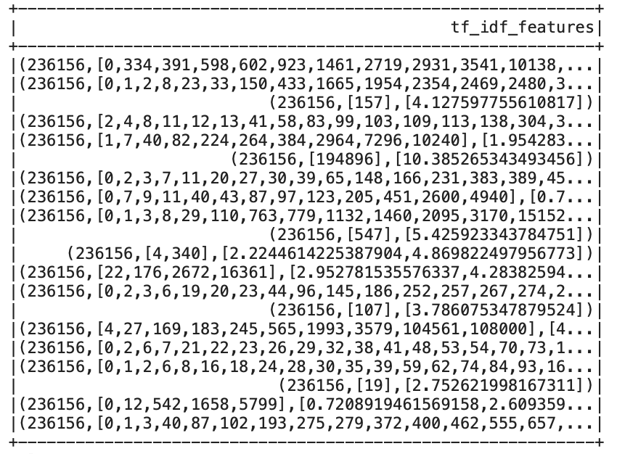
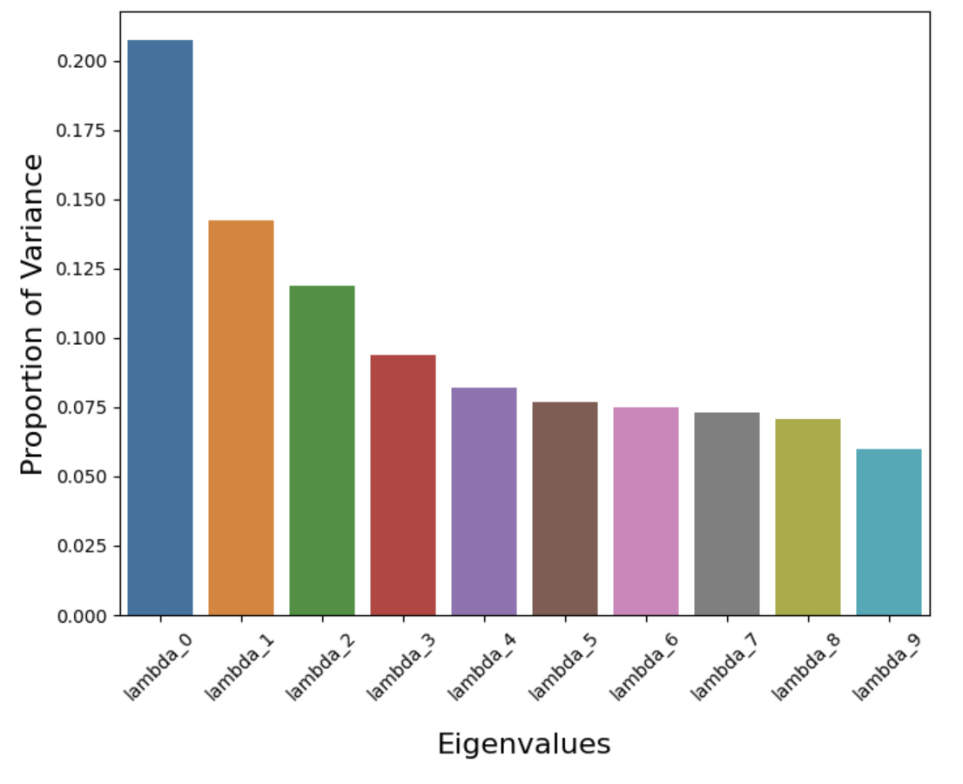
Feature Extraction
TF-IDF
PCA
A statistical metric employed to assess the significance of a word within a document in a corpus that that combines two key concepts:
Term frequency (TF),
Inverse document frequency (IDF).
Principal Component Analysis (PCA) is a statistical technique used for dimensionality reduction.

Slide 11
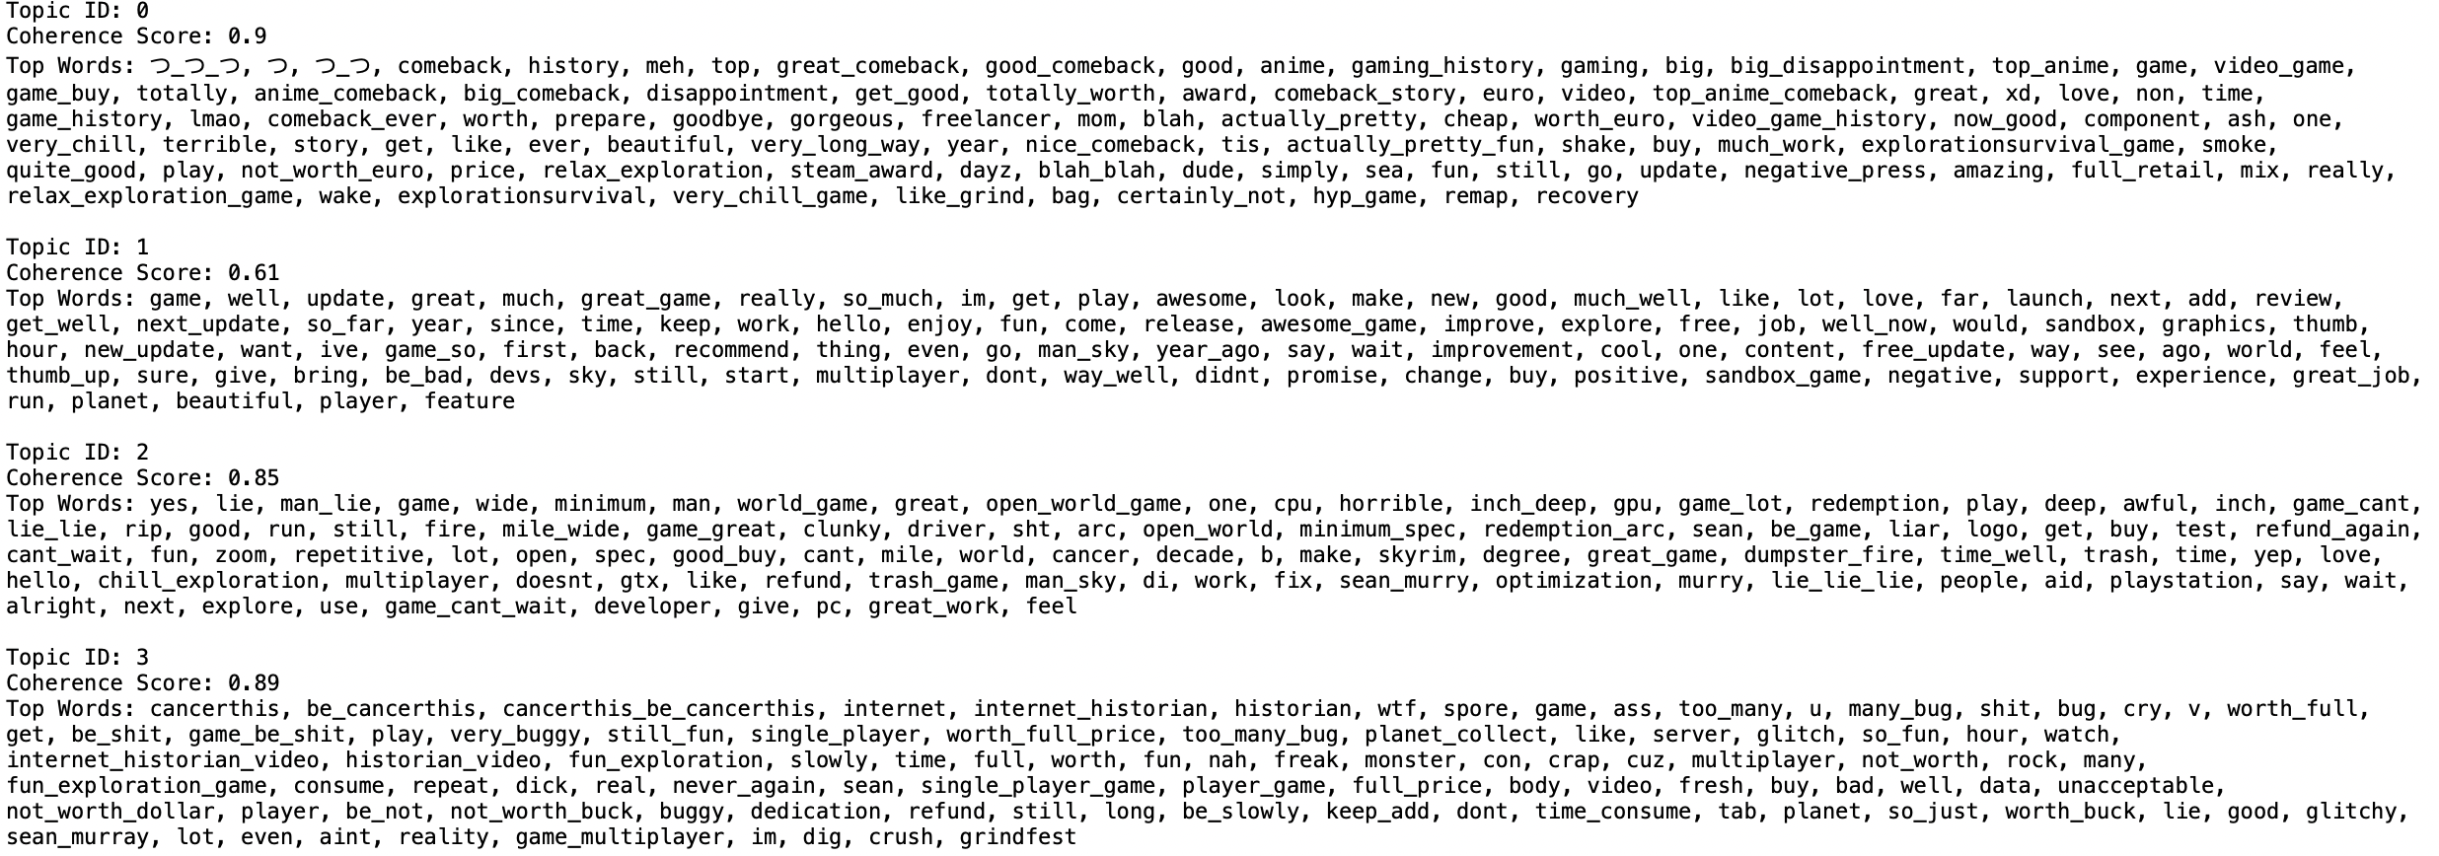
LDA & Coherence Score
Coherence Score by Gensim
LDA(Latent Dirichlet Allocation)

Slide 12
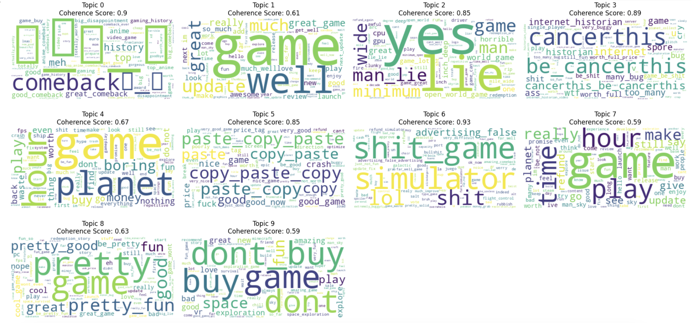
Word Cloud and Topic Choice
ID 5
POSITIVE
ID 2
NEGATIVE
FUNCTIONALITY

Slide 13
Word Cloud and Topic Choice
ID 0
POSITIVE
ID 3
NEGATIVE
GAMEPLAY

Slide 14
Word Cloud and Topic Selection
ID 9
POSITIVE
ID 6
NEGATIVE
USABILITY

Slide 15
Machine Learning hypothesis
Does there exist a relationship between the text of the review and the number of votes up received?
Predict and Performance
Data Balancing
Distribution of votes up and Undersampling
BoW (Bag-of-Words)

Slide 16
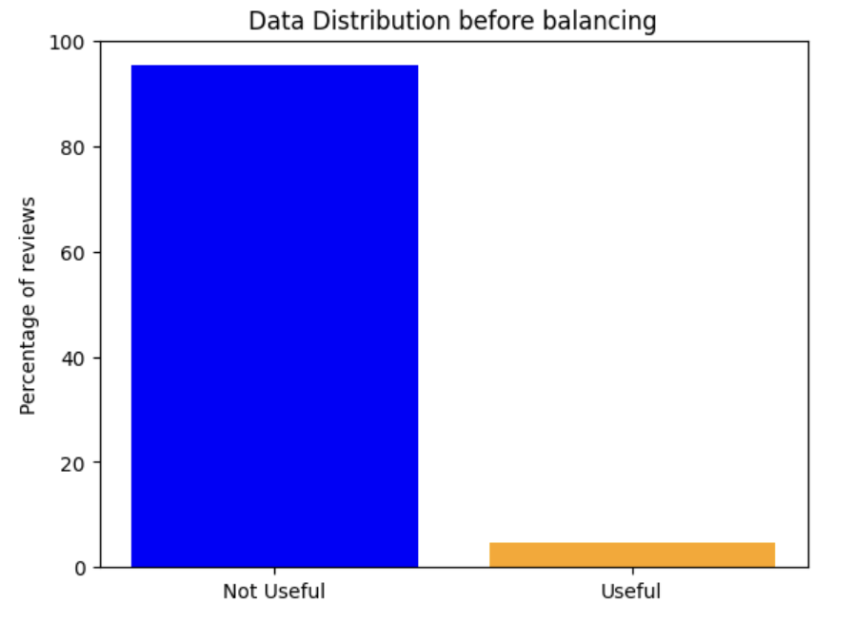
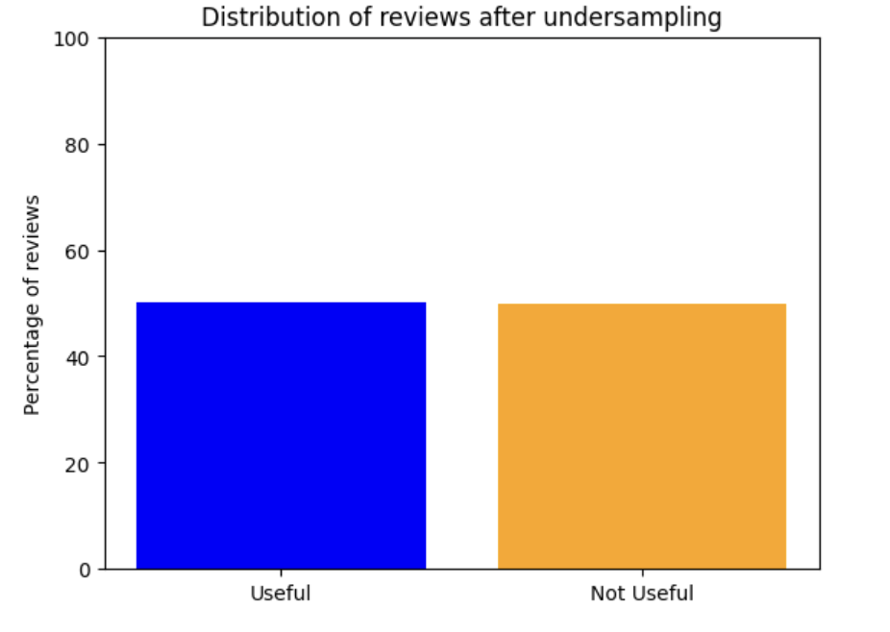
Data Balancing
Before
After

Slide 17
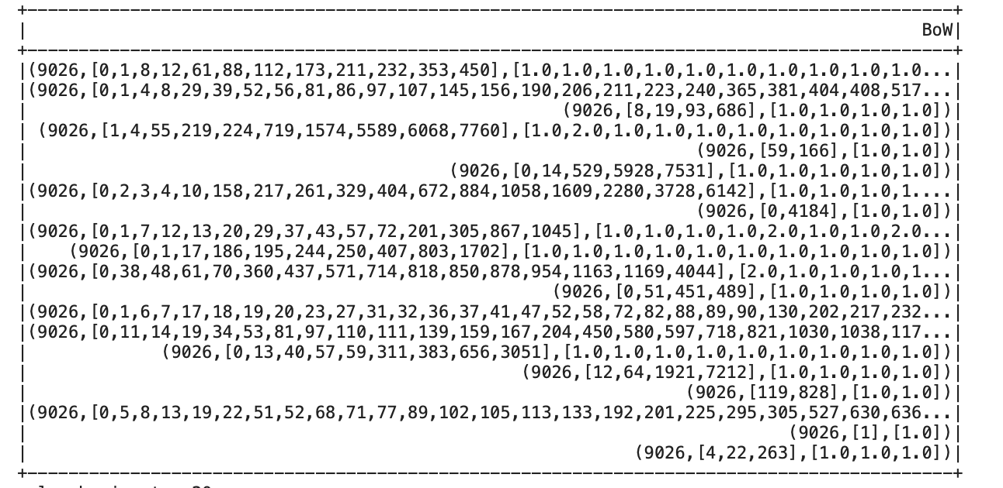
Bag of Words (BoW)

Slide 18
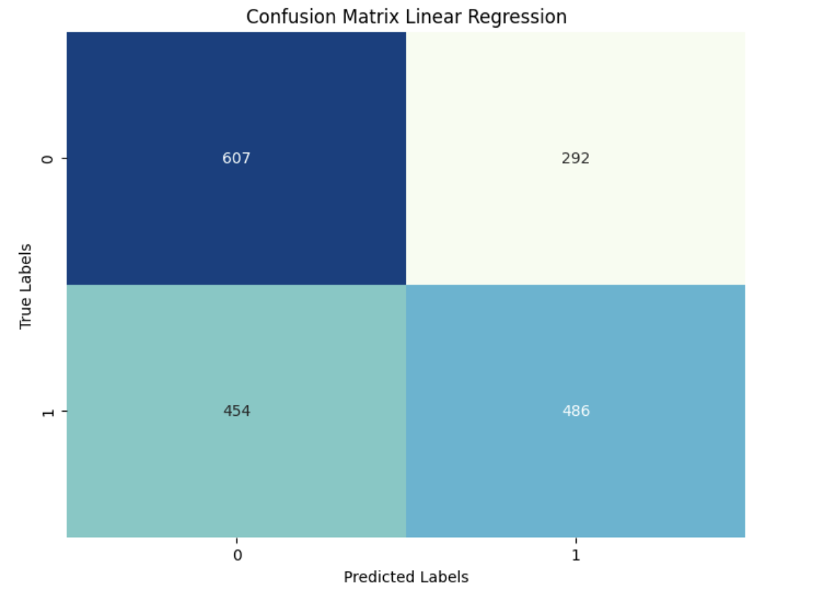
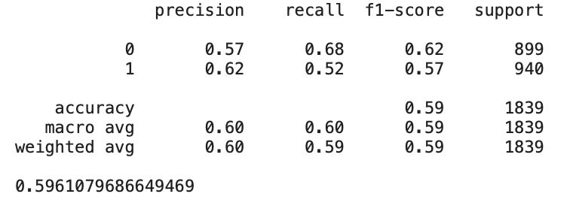
Logistic Regression Performance
JUPITER
MARS
VENUS
NEPTUNE

Slide 19
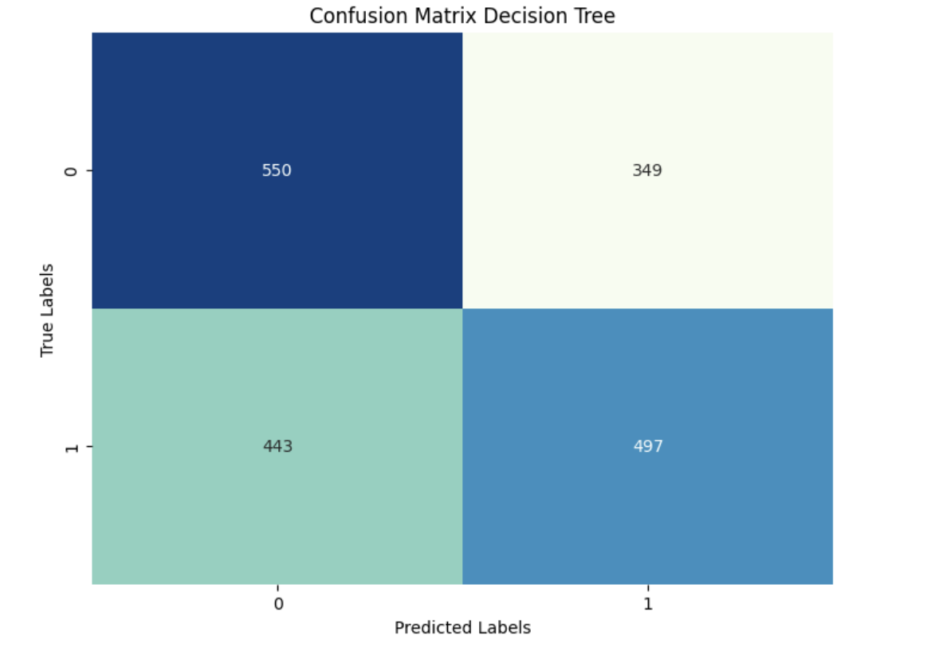
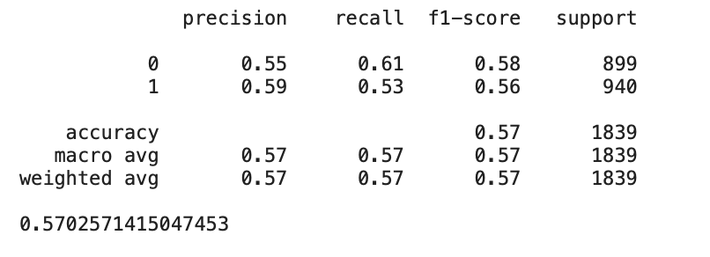
Decision Tree Performance
JUPITER
MARS
VENUS
NEPTUNE

Slide 20
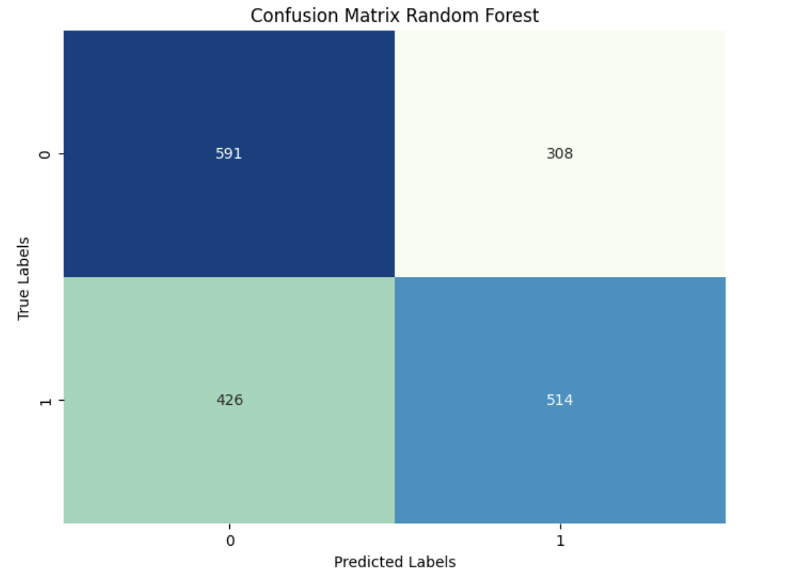
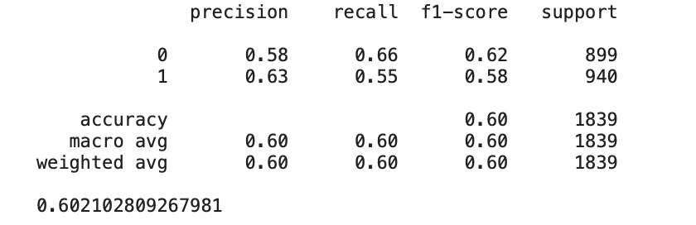
Random Forest Performance
JUPITER
MARS
VENUS
NEPTUNE

Slide 21
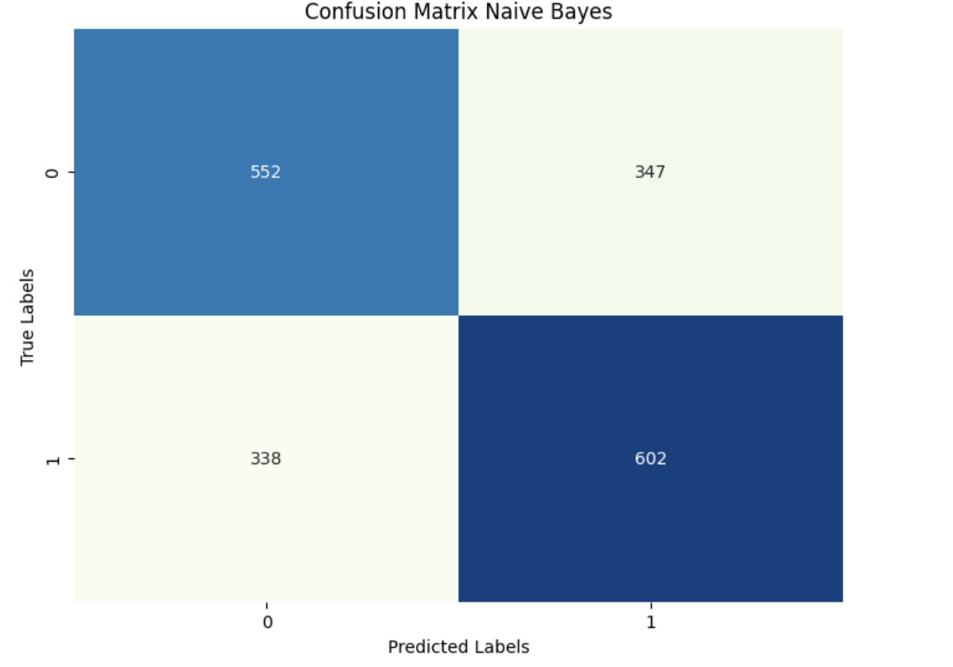

Naïve Bayes Performance
JUPITER
MARS
VENUS
NEPTUNE

Slide 22
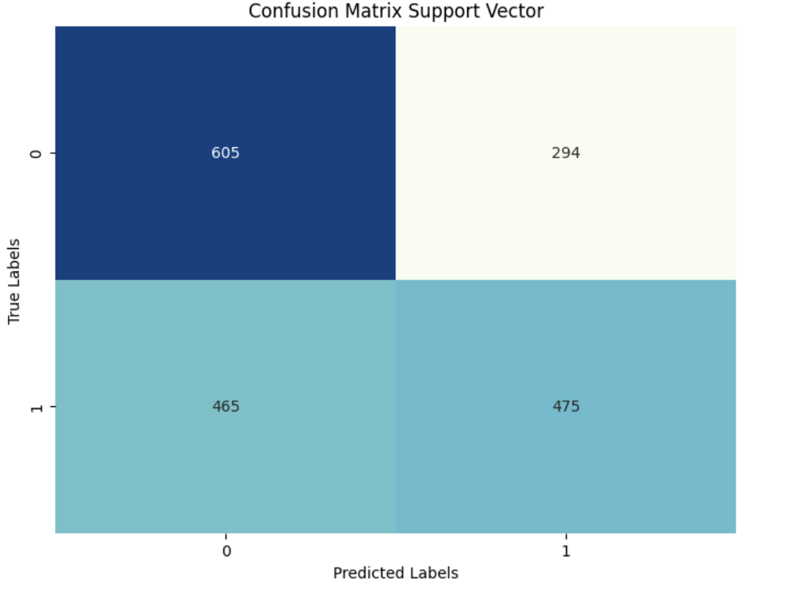
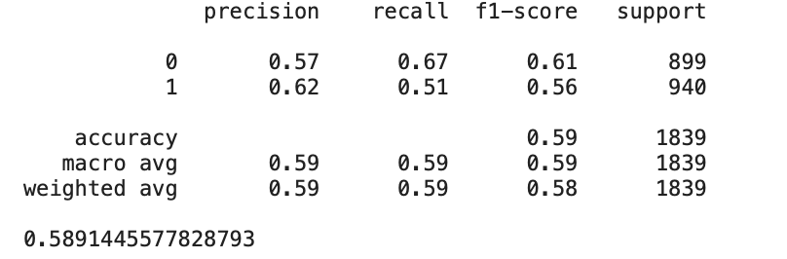
Support Vector Performance
JUPITER
MARS
VENUS
NEPTUNE

Slide 23
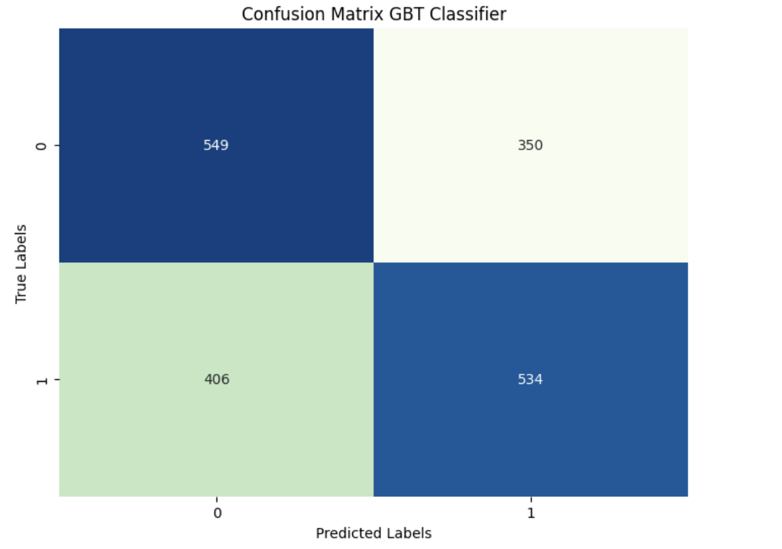

Gradient Boost Tree Performance
JUPITER
MARS
VENUS
NEPTUNE

Slide 24
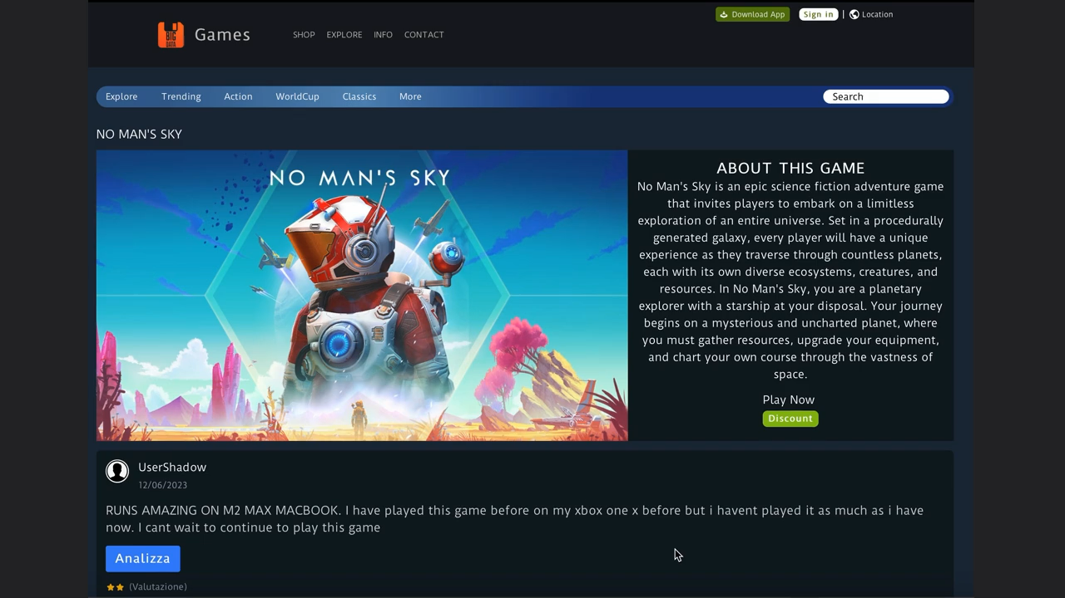
Demo

Slide 25
Future goals
Improve and explore new Machine learning techniques (such as BERT or Word2VEC )
Collect better data, and create a more representative and suitable dataset
Automate the process of topic selection and analysis

Slide 26
THANKS FOR THE ATTENTION

